Slide 1

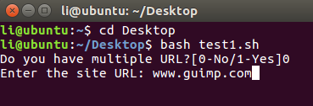
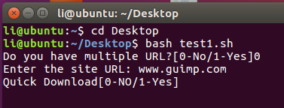
OS PROJECT ON WGET SCRIPT
By Nishant Jain(169105117)
Introduction to the code:
Code is stored on Desktop.
The User interface is User friendly and provides 2 options.
Quick download.
Mirror download.

Slide 2
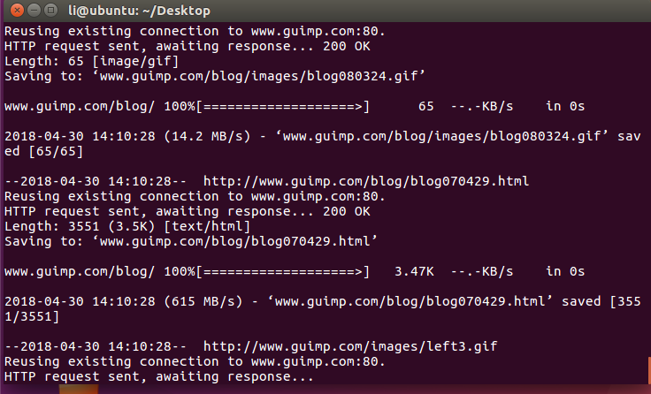
Theory
Wget utility which retrieves files from World Wide Web (WWW) using widely used protocols like HTTP, HTTPS and FTP.
Wget utility is freely available package and license is under GNU GPL License. This utility can be install any Unix-like Operating system including Windows and MAC OS.
It’s a non-interactive command line tool. Main feature of Wget of its robustness. It’s designed in such way so that it works in slow or unstable network connections.
Wget automatically start download where it was left off in case of network problem. Also downloads file recursively. It’ll keep trying until file has be retrieved completely.
to get a complete mirror of a website you can simply use the following switch which takes away the necessity for using the -r -k and -l switches.
wget -m www.guimp.com
The script in the test1.sh has two features which provides users with two downloading options
QUICK DOWLOAD
For single url -> cd imp/ && wget -cr -t10 "$url" || exit 1

Slide 3
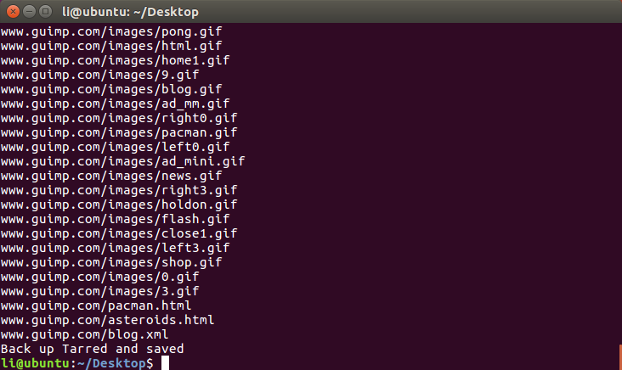
For multiple url-> cd imp/many && wget -cr -t10 -i "$path" || exit 1 && cd ..
The file actually gets downloaded recursively for up to 5 levels which is suitable for viewing a site’s pages but not all. But it saves a lot of time in downloading and
space.
MIRROR DOWNLOAD
For single url -> cd imp/ && wget -cm -t10 "$url" || exit 1

Slide 4

For multiple url-> cd imp/many && wget -cm -t10 -i "$path" || exit 1 && cd ..
To get a complete mirror of a website you can simply use the following switch which takes away the necessity for using the -r -k and -l switches.
Specifications to test1.sh program-
In case of any failure the script is coded in such a way that it exits from the code displaying the error message and doesn’t proceed further in the code
making it user friendly.

Slide 5
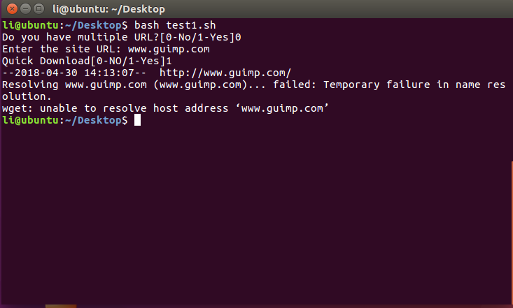
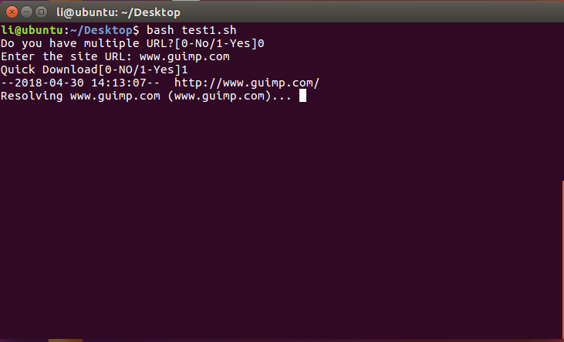
The –c or –continue is used to download the web pages if the pages were already in the process of download and somehow the code failed and exited the
program.
The –t10 here signifies and restricts the code to do only maximum of only 10 or at least 10 tries before failing and notifying the user, evident from the snippets.
Imp is the folder where the original web files are saved and the tar and zipped files are saved in the backup folder which is a new directory.
The –i here is used for downloading the files from a .txt files incase if the user wants to download multiple web pages or if he wants to download the web pages’
user desires all at once.

Slide 6
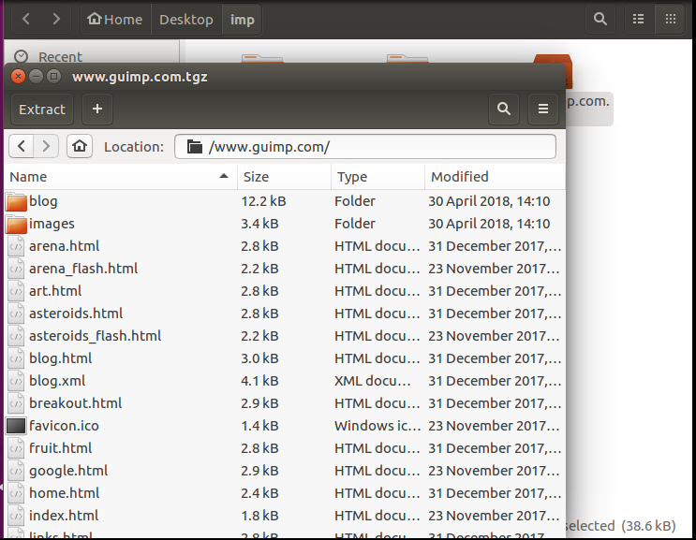
The next phase of the code was to tar and gzip the downloaded web files and saving them in new directory.
A TAR.GZ file is a TAR archive compressed with the standard GNU zip (gzip) compression algorithm. It contains one or more compressed files and is
commonly used on Unix operating systems to package files, programs, and installers.
For single url-> tar -zvcf "$url".tgz "$url" || exit 1
For multiple url-> tar -zvcf many.tgz many || exit 1
tar zvcf file.tar.gz
The letters are:
z - gun zip the input.
f - Read from a file, not stdin.
c – Creates a new .tar archive file.
v – Verbosely show the .tar file progress.
Refernces: internet

Slide 7
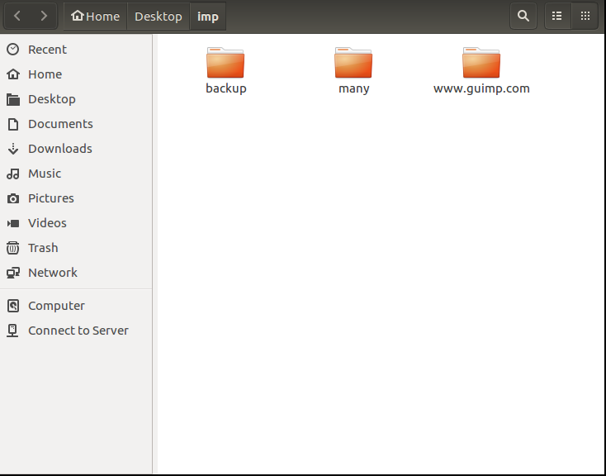
ADDITIONAL SNIPPETS OF THE PROGRAM

Slide 8
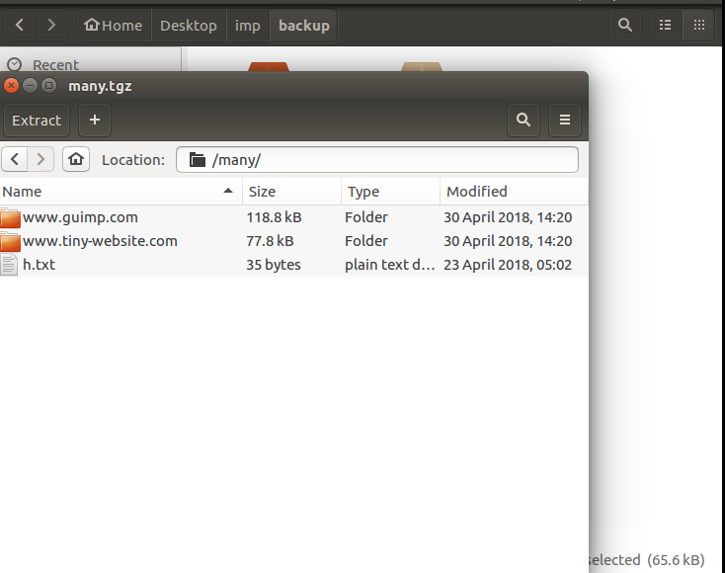

Slide 9
Thank You

